Slide 1
Dallas Hill
Junior Web Dev

Slide 2
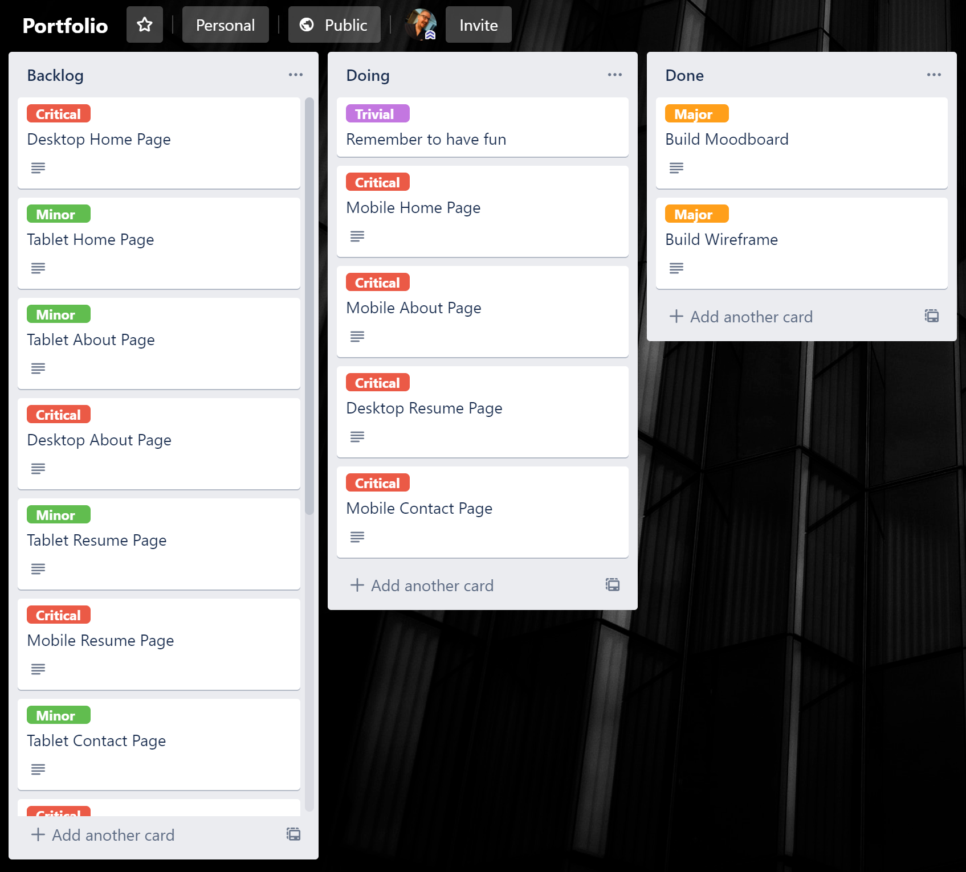
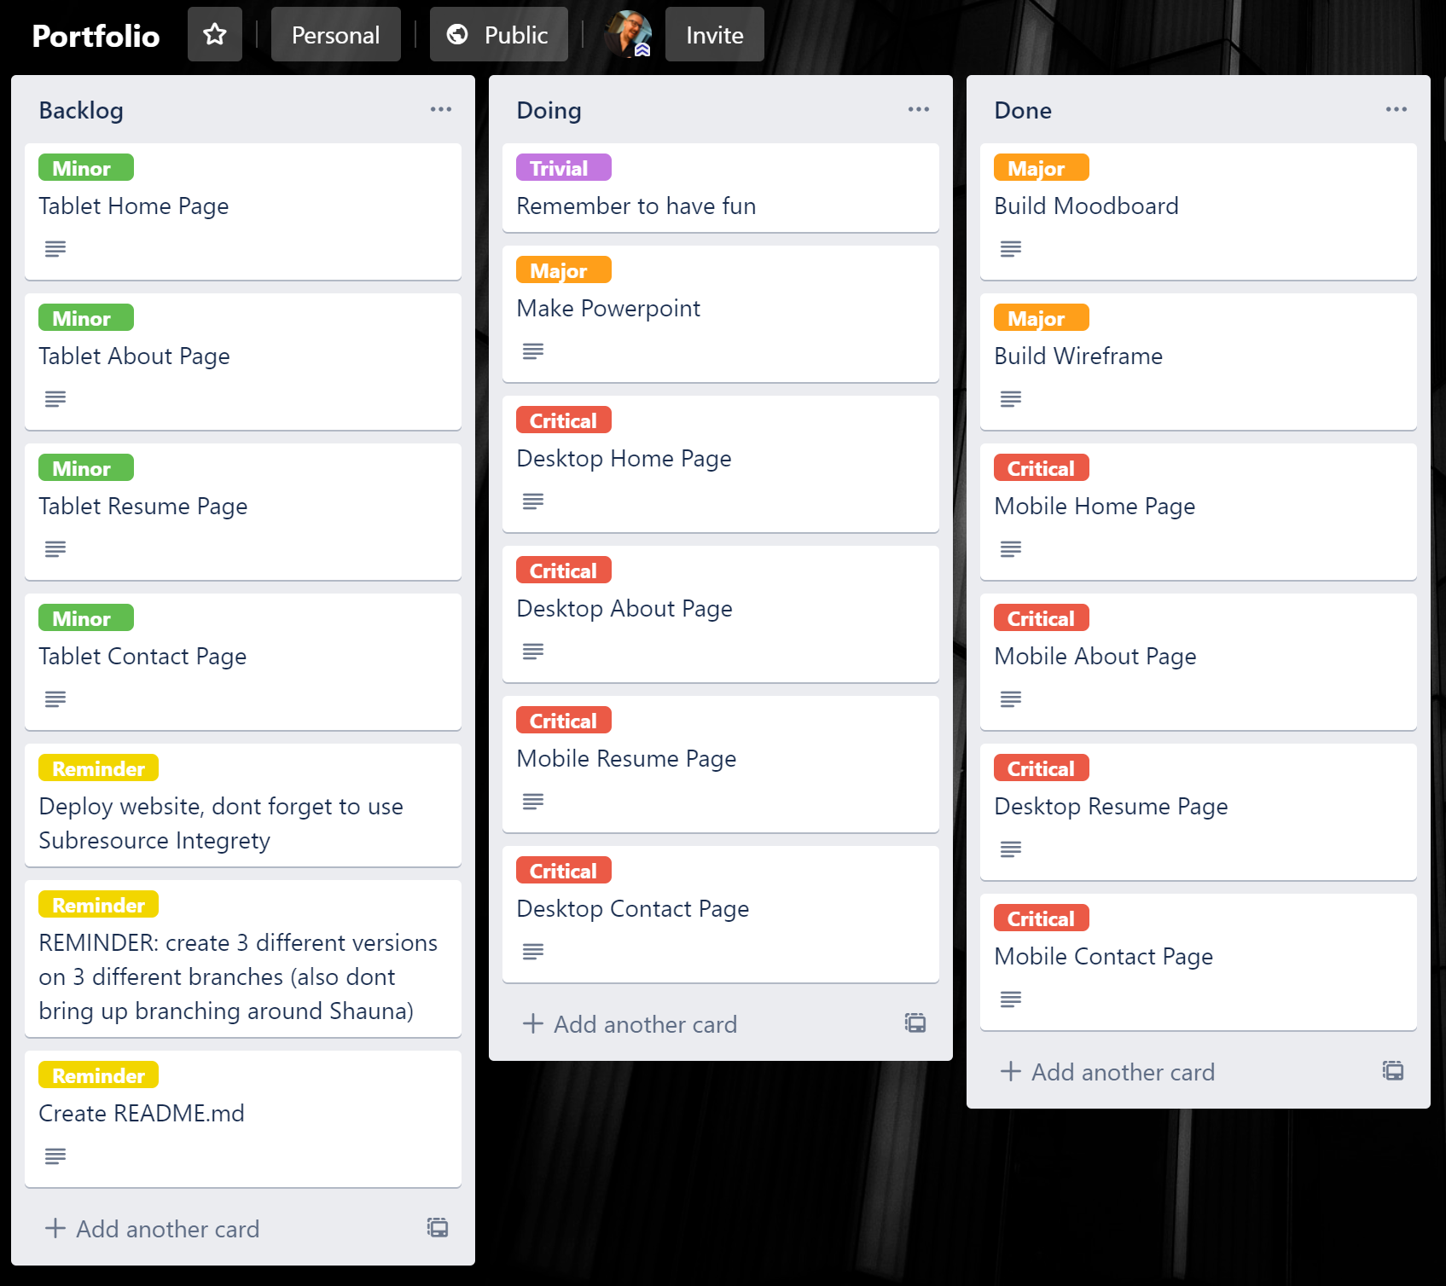
Lets go Trello boarding!
ser experience
Physical Computing
HTML, CSS,JS

Slide 3
Mood boarding shmood boarding

Slide 4
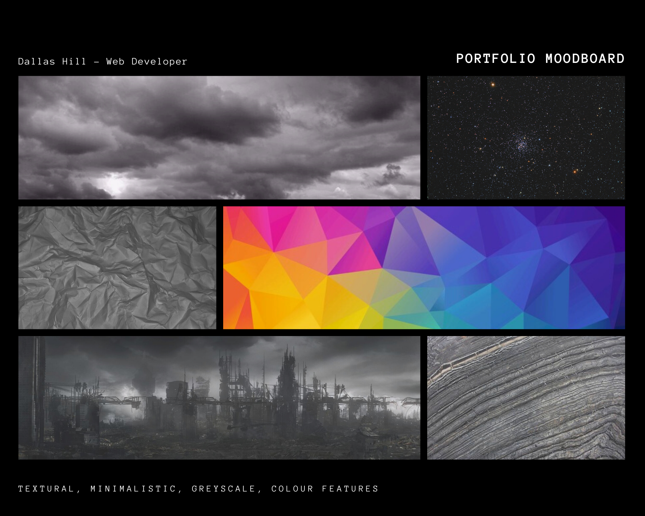
This is my mood board, I wanted my site to be mostly black and white with touches of colour when you hovered over things

Slide 5
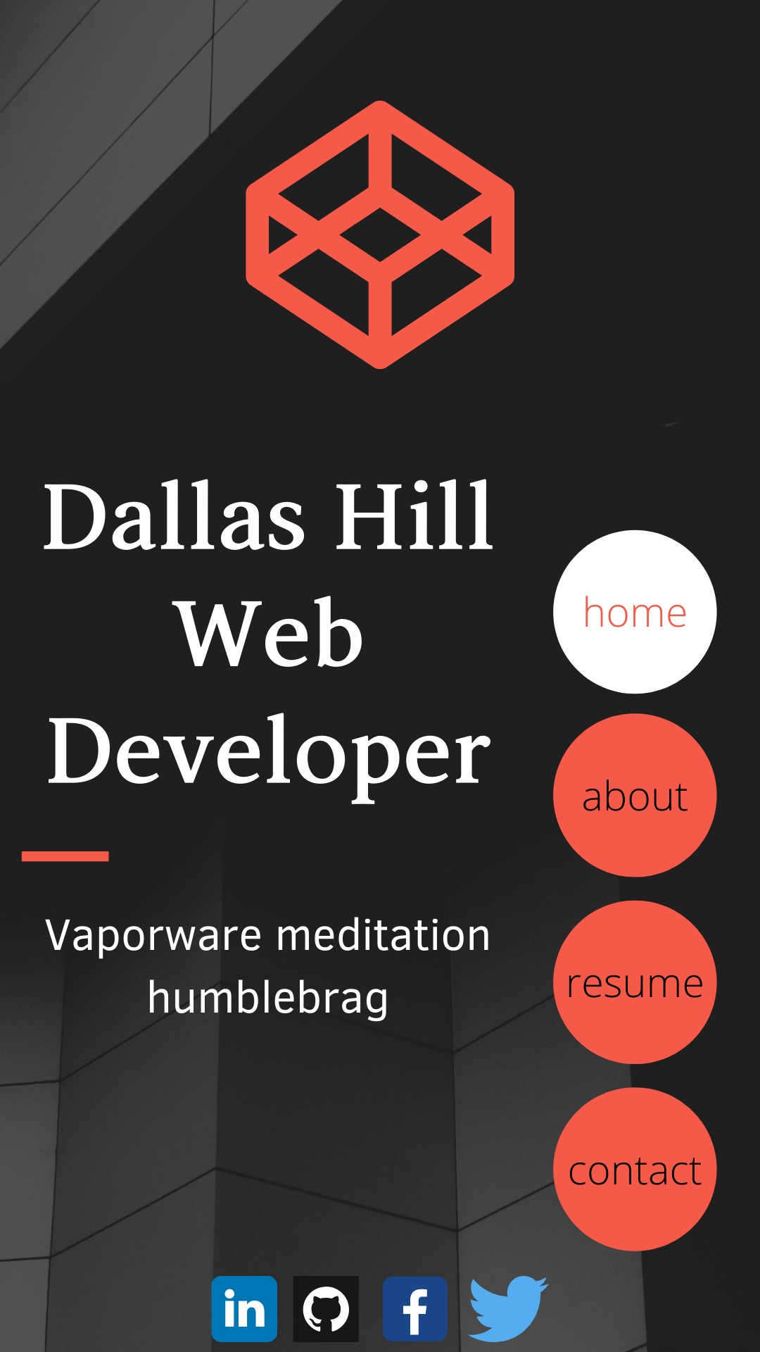
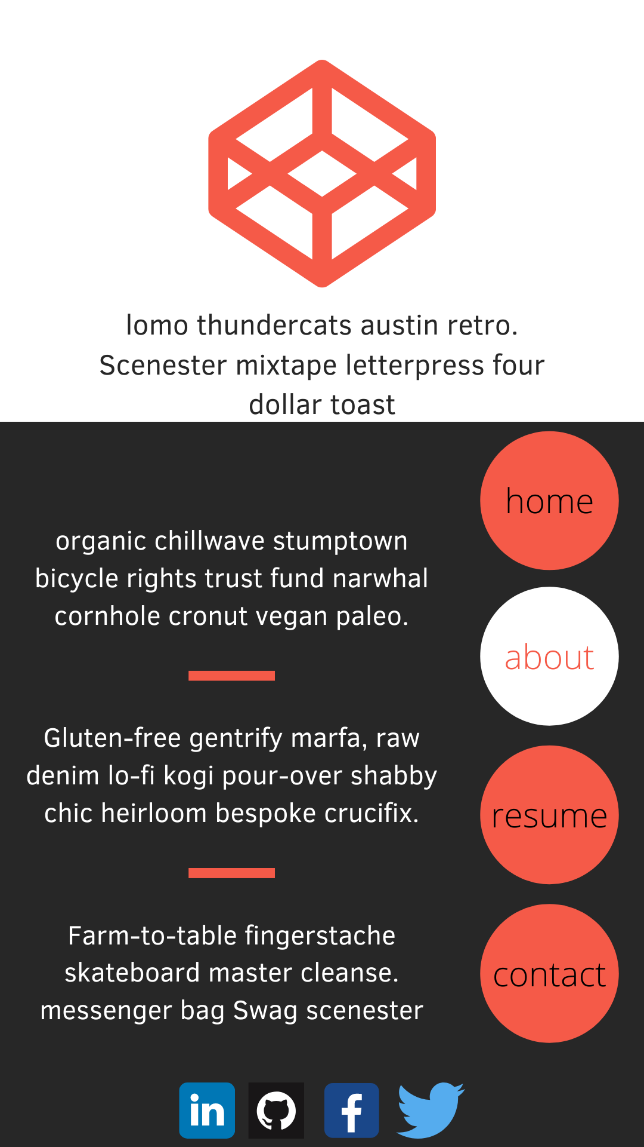
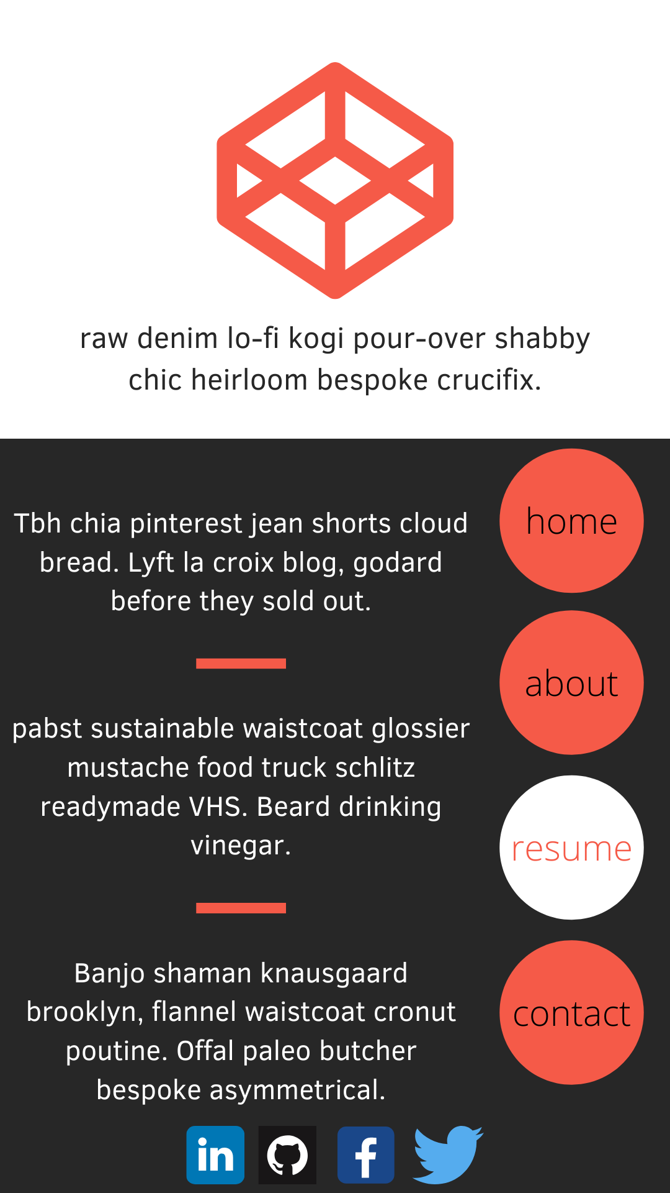
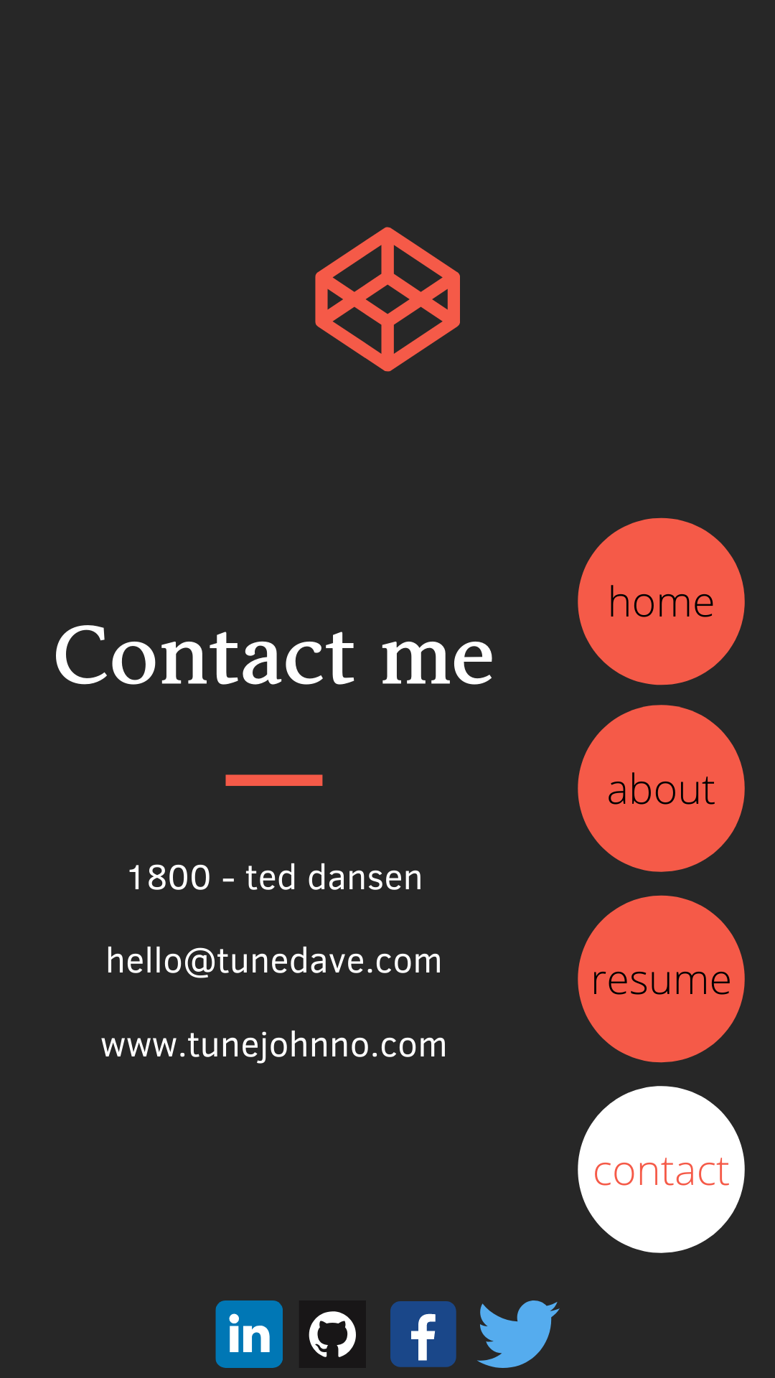
Mobile first...

Slide 6
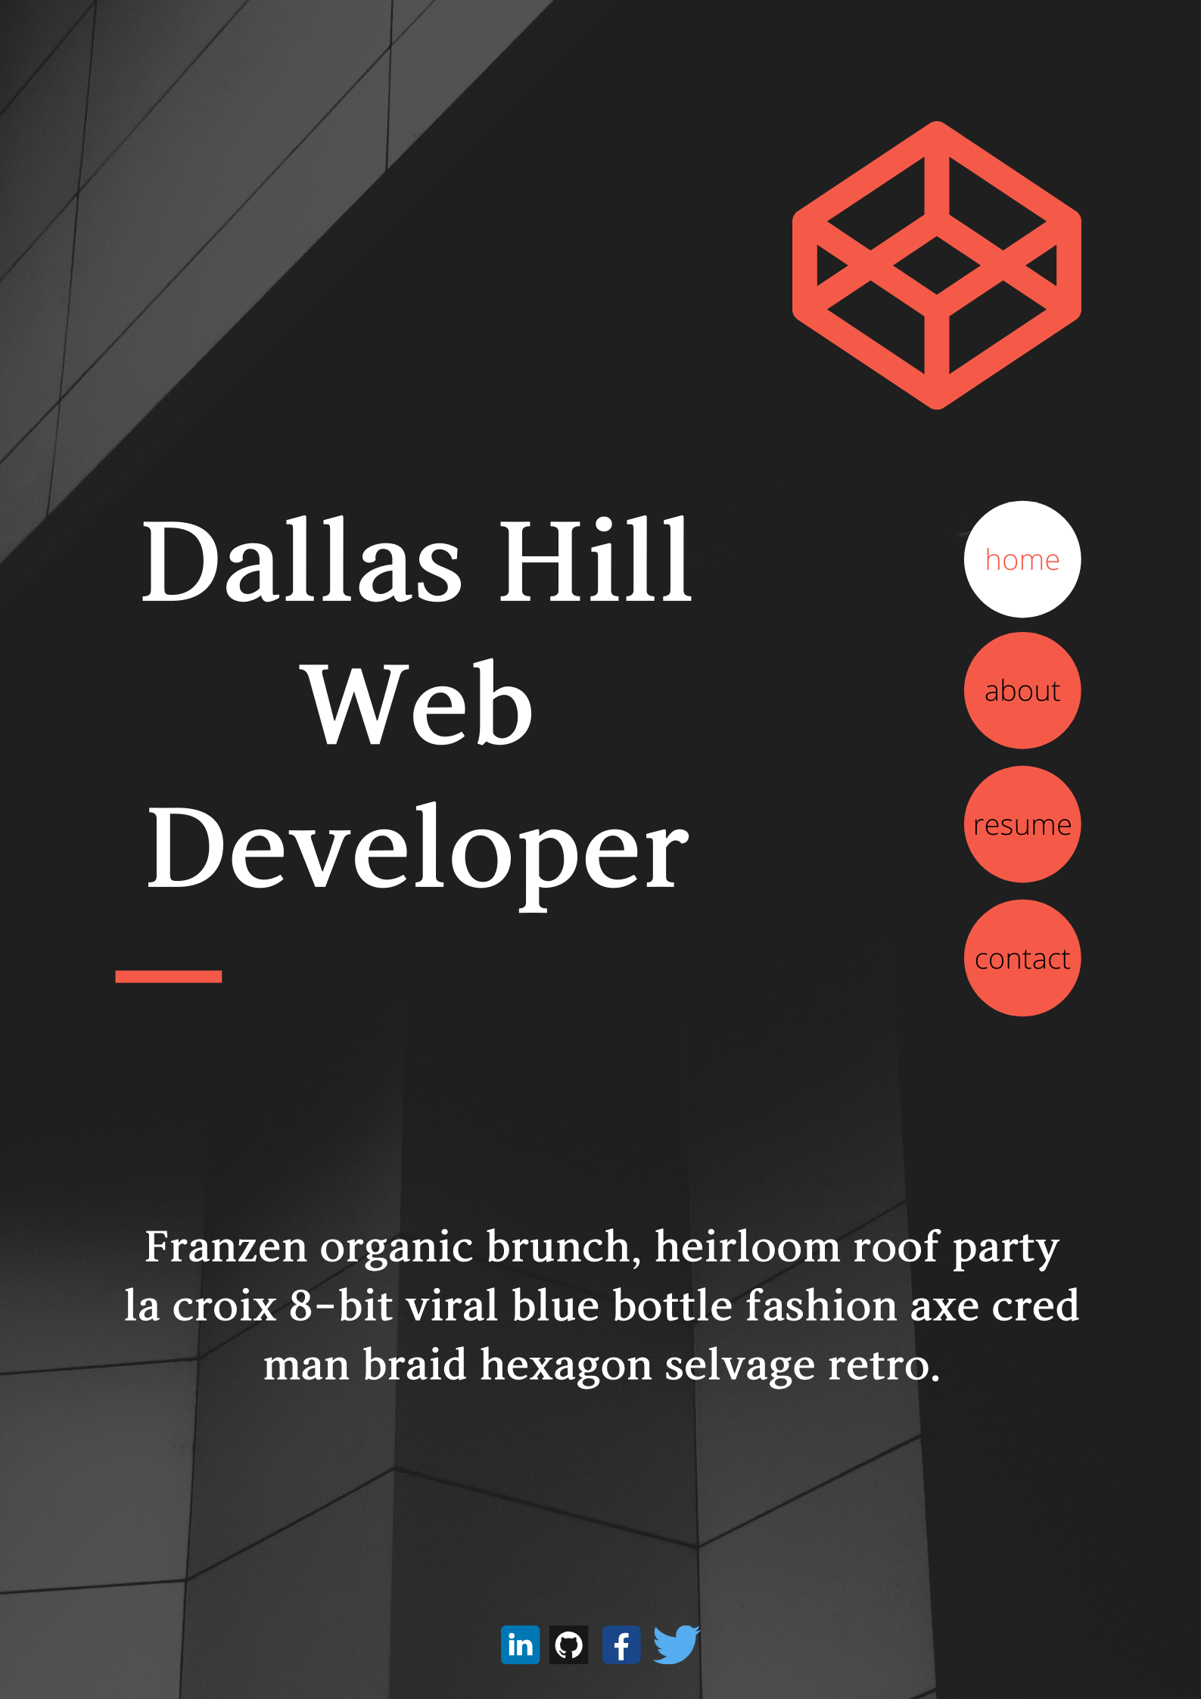
Tablet view
Portrait mode

Slide 7
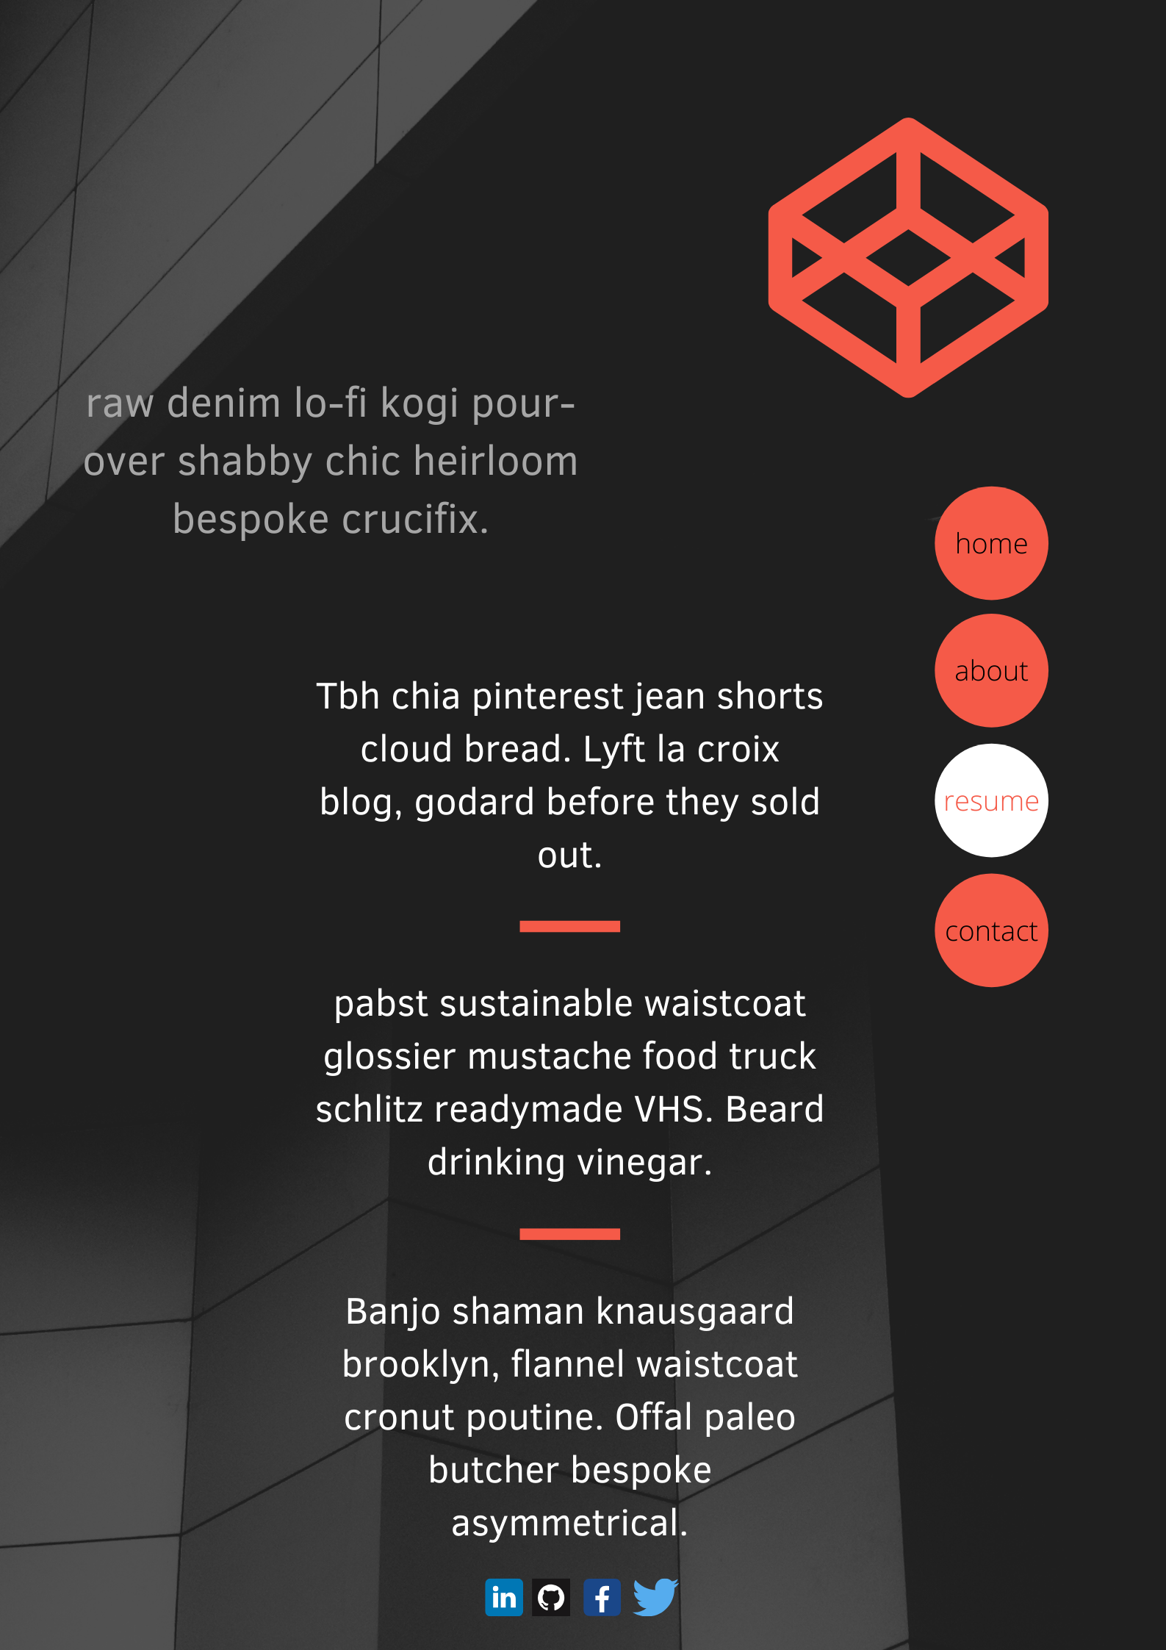
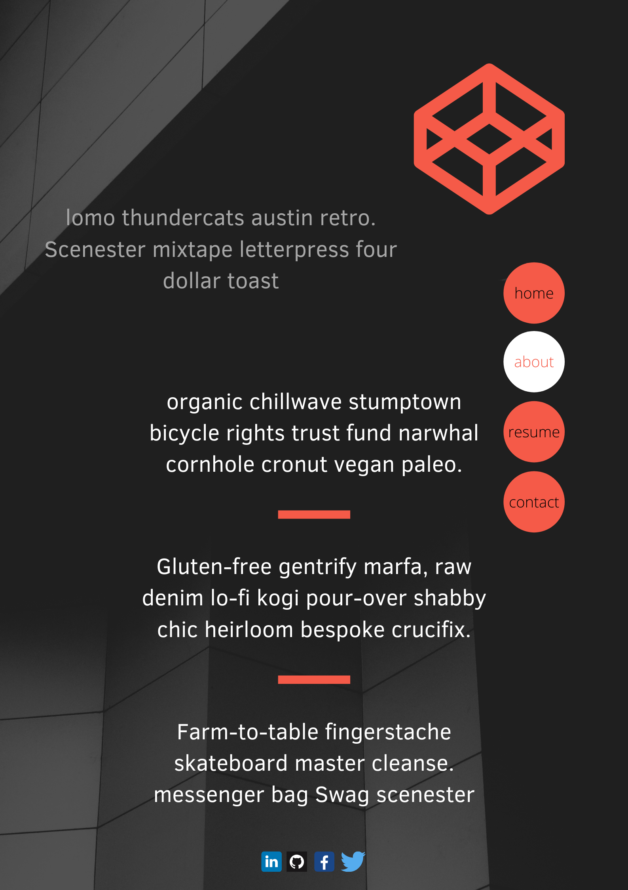
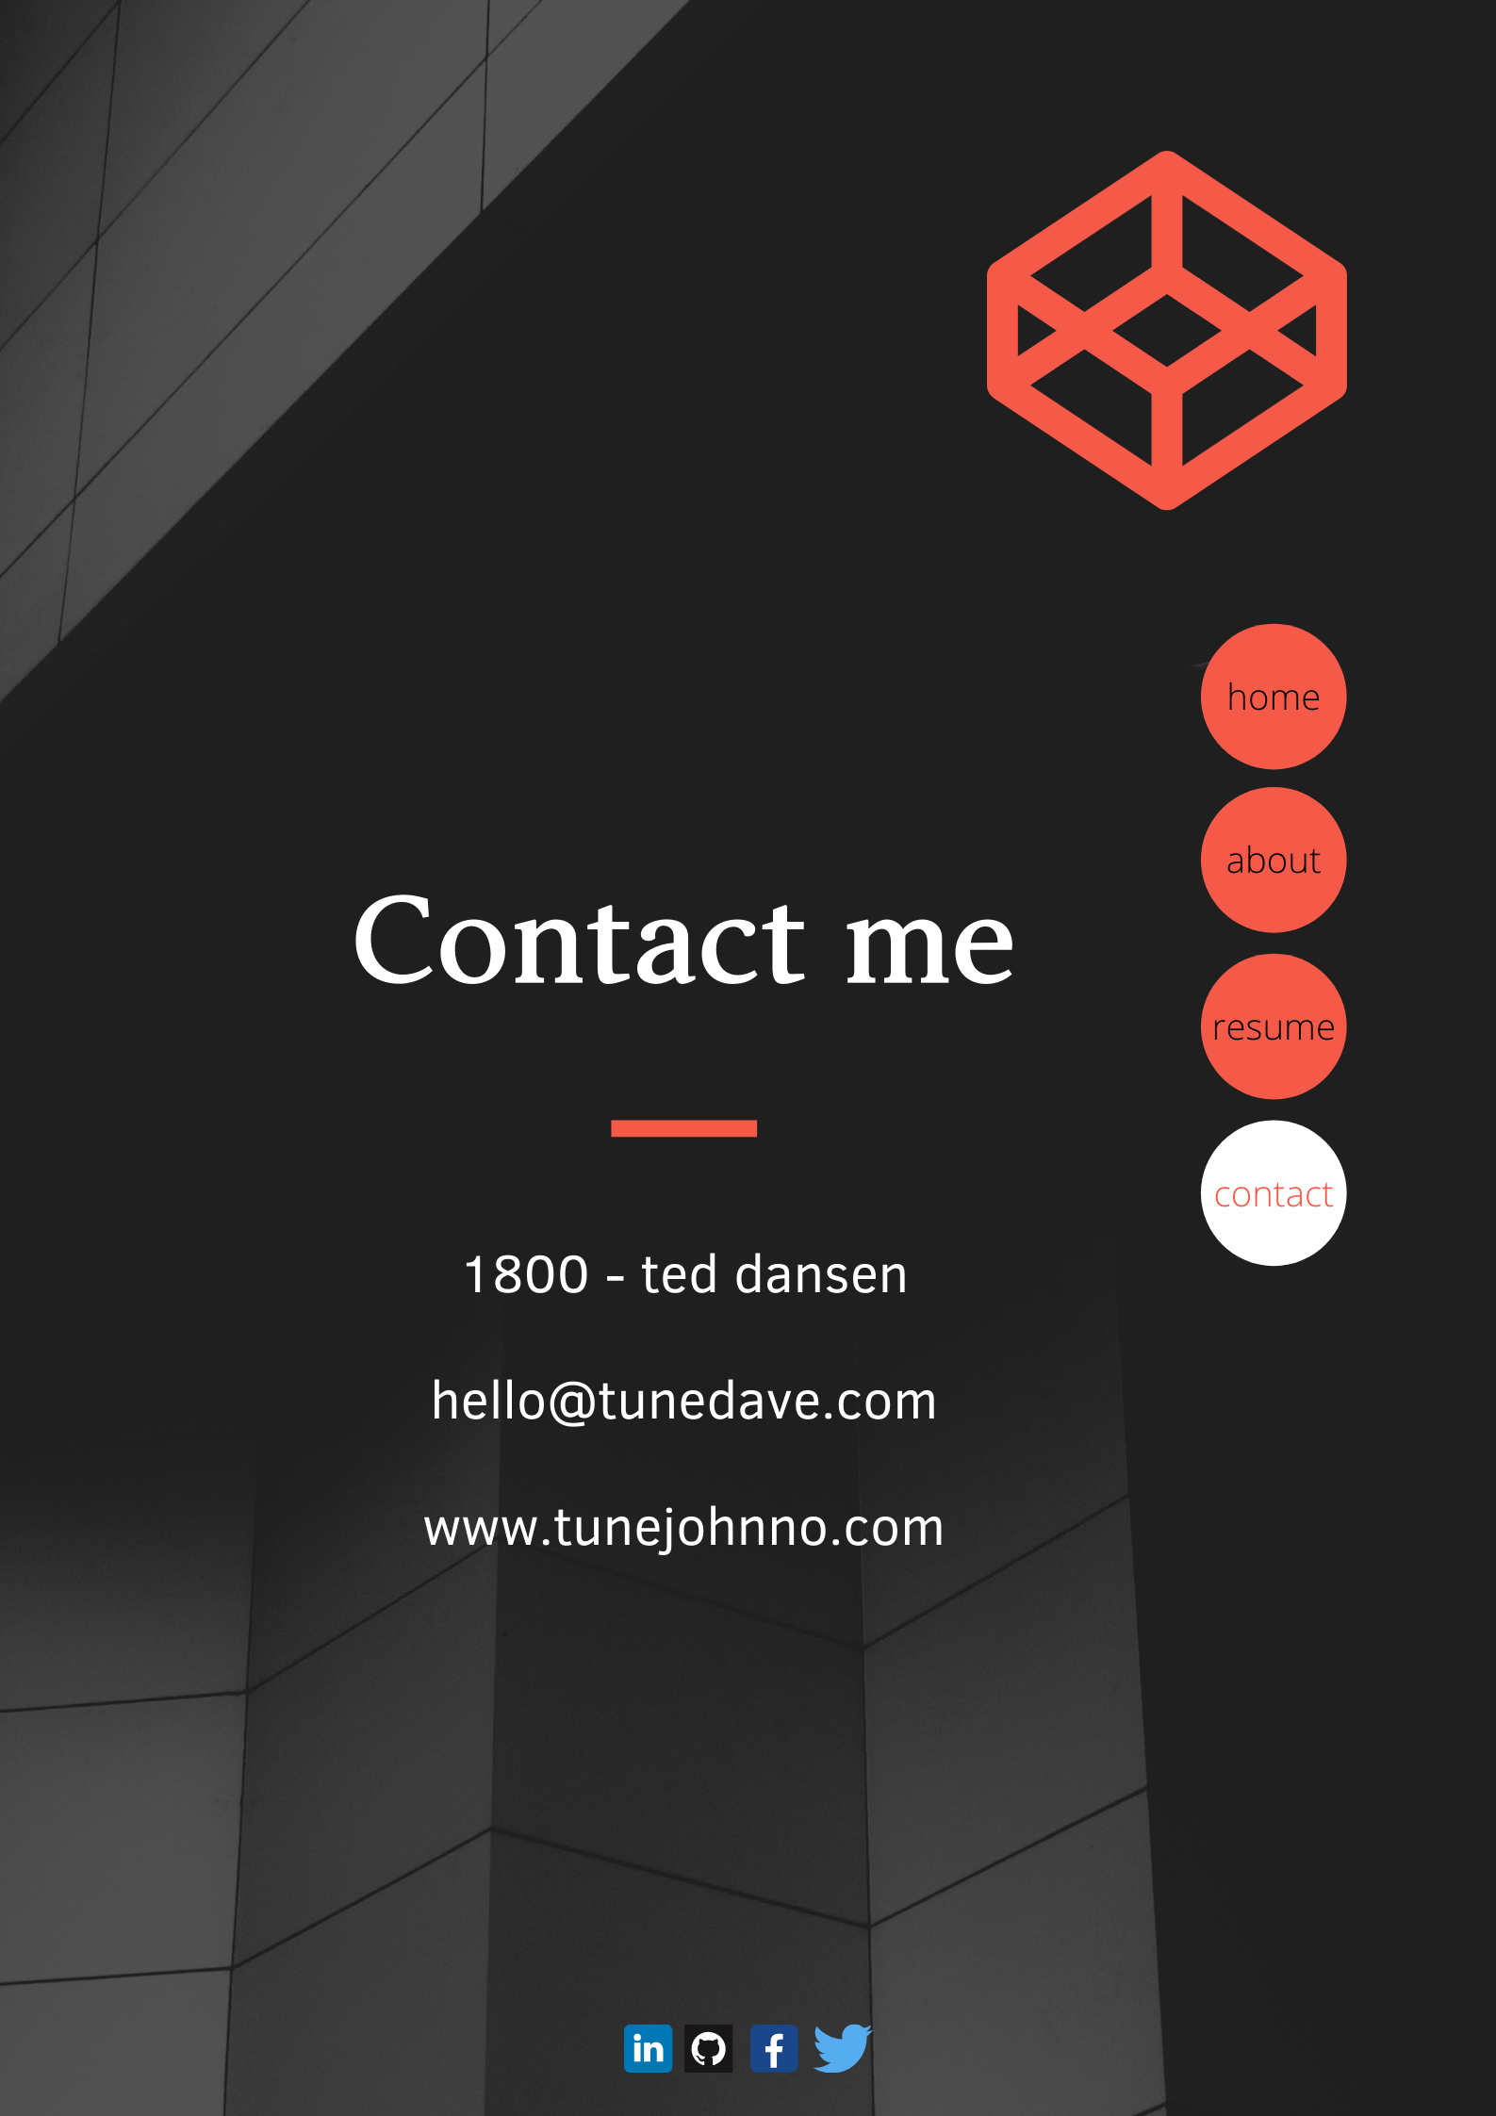

Slide 8
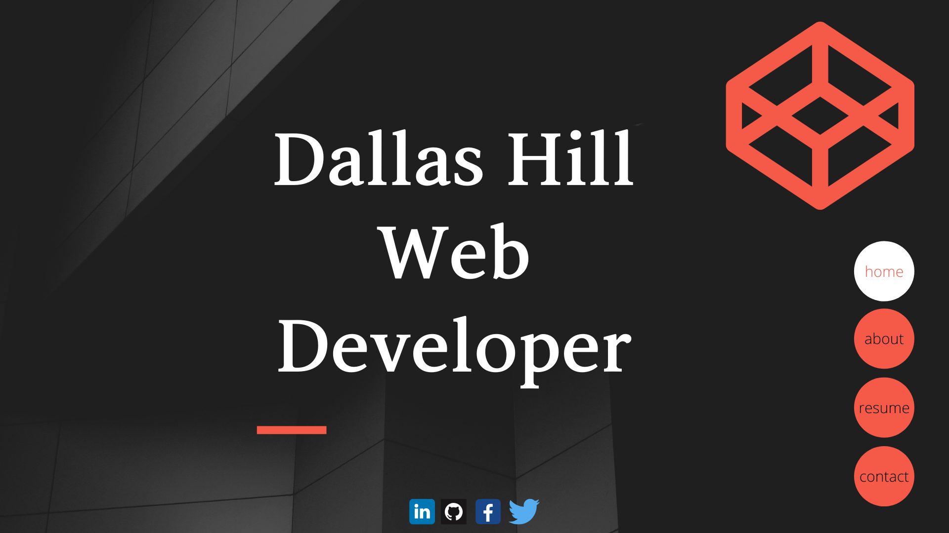
Desktop view/tablet landscape view

Slide 9
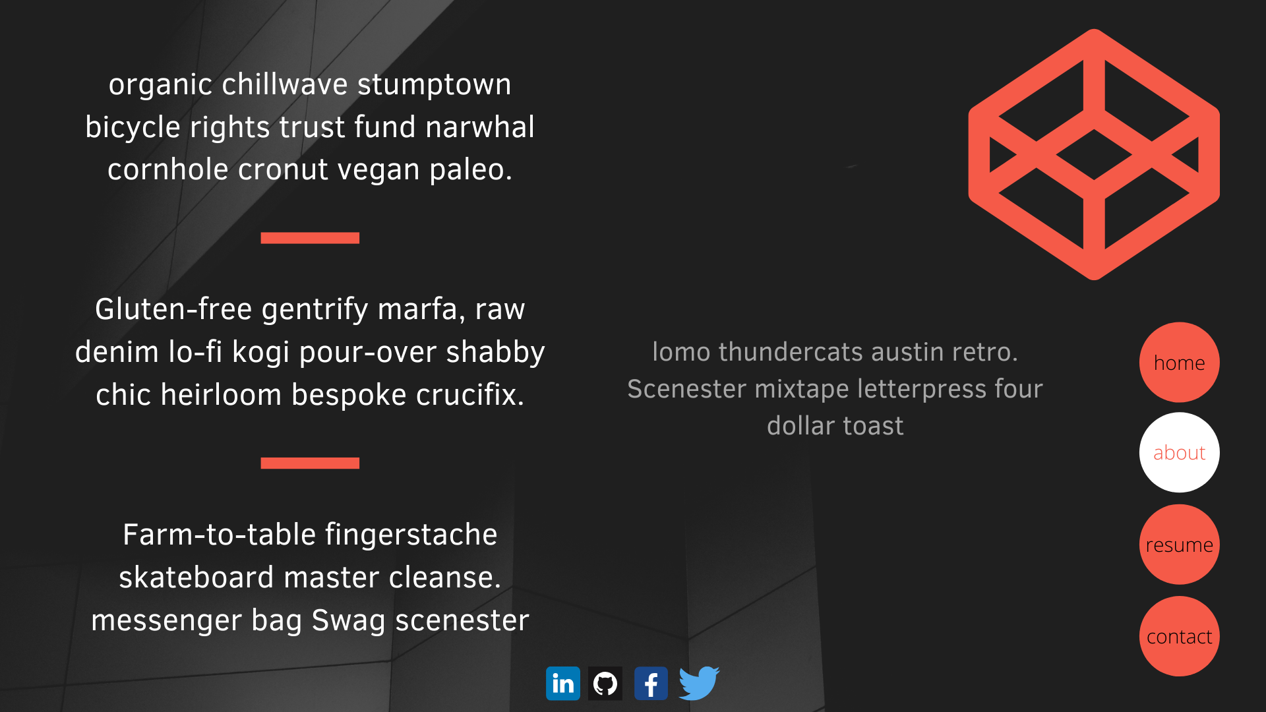

Slide 10
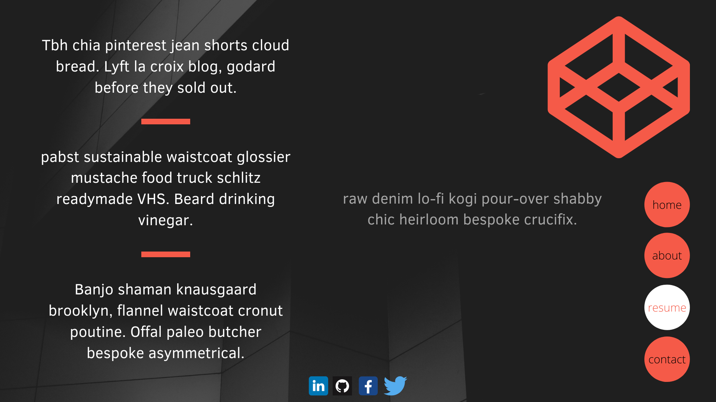

Slide 11
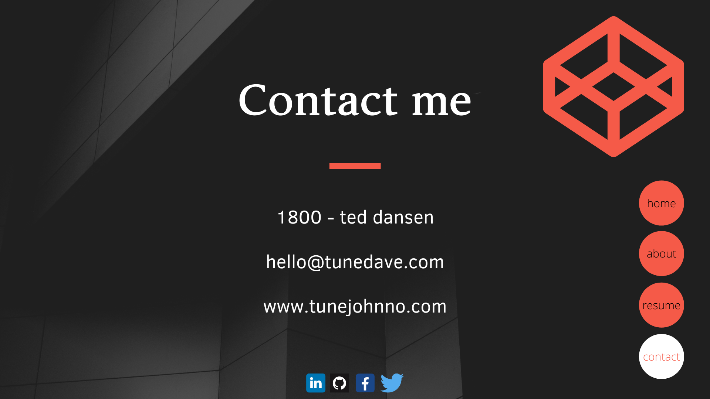

Slide 12
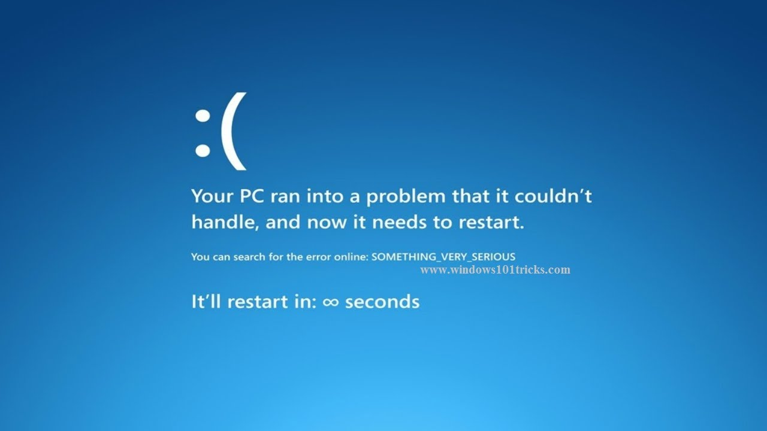
Components!
Component 1 - popup modal with a link to my Resume PDF
Component 2 - Contact sheet that links directly to linkedIn messages

Slide 13
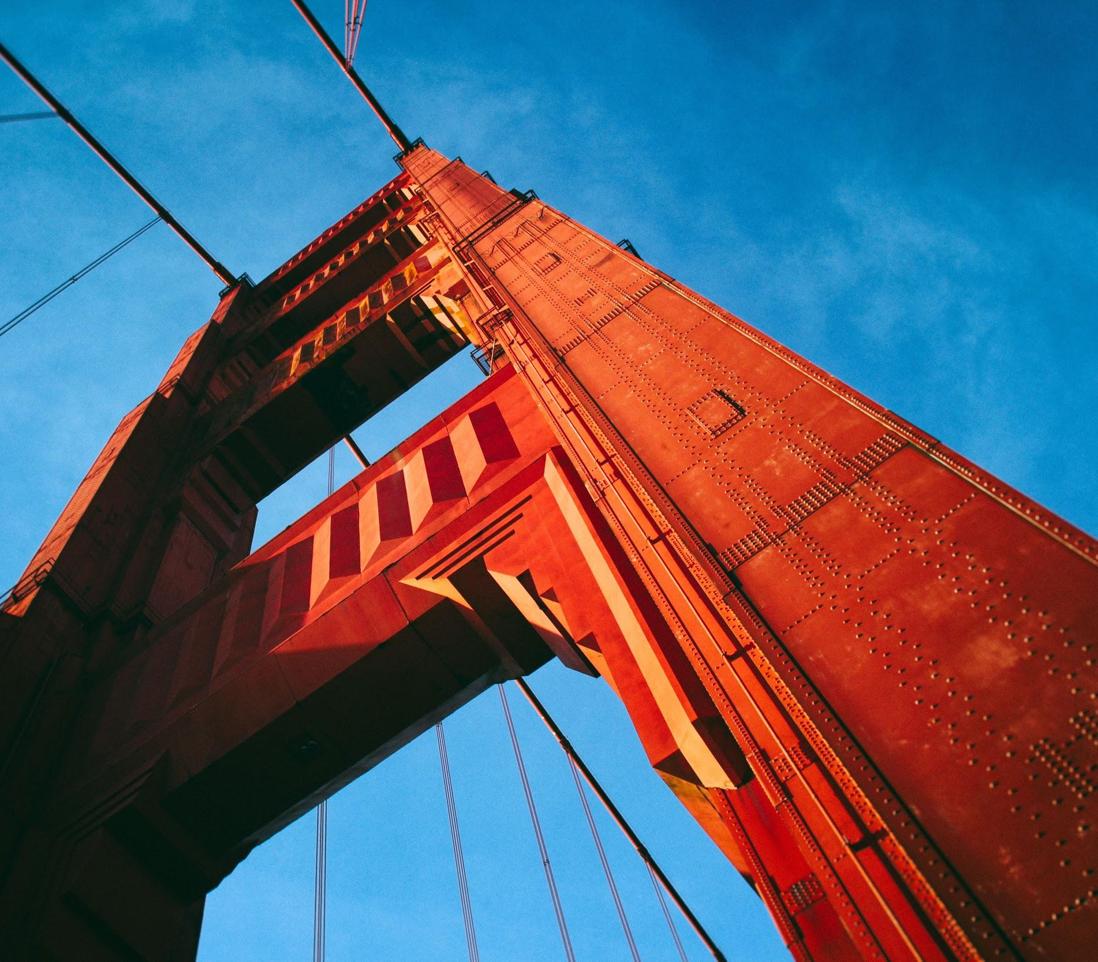
Components
IF I HAD ANY COMPONENTS YET, I’D LIST THEM HERE...

